Slide 1

Randomized Algorithms CS648
Lecture #
Tools for P[$X>(1+δ)E[X]$]

Slide 2
Some Well Known and Well STUDIED Random Variables

Slide 3


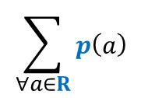

Probability mass function
For a random variable $X$ defined over a discrete probability space (Ω,P)
mass function $p$ is defined as follows.
Question: What is ?
Answer: $1`$
$$p\left(a\right)$$
$$= P(X=a)$$
$$\sum_{∀a∈R}{p\left(a\right) }$$

Slide 4
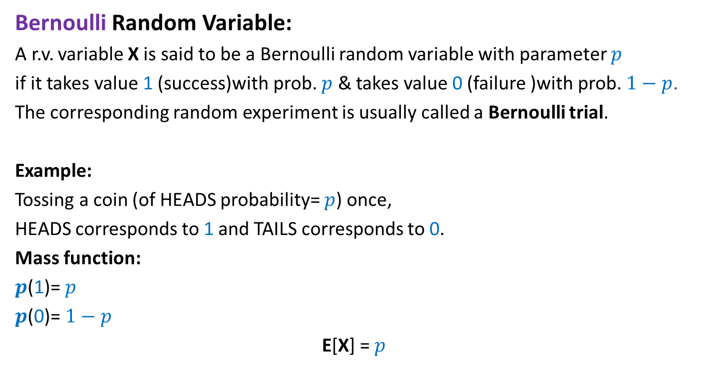
Bernoulli Random Variable
Bernoulli Random Variable:
A r.v. variable X is said to be a Bernoulli random variable with parameter $p$
if it takes value 1 (success)with prob. $p$ & takes value 0 (failure )with prob. $1−p$.
The corresponding random experiment is usually called a Bernoulli trial.
Example:
Tossing a coin (of HEADS probability= $p$) once,
HEADS corresponds to 1 and TAILS corresponds to 0.
Mass function:
$p$(1)= $p$
$p$(0)= $1−p$
E[X] = $p$

Slide 5

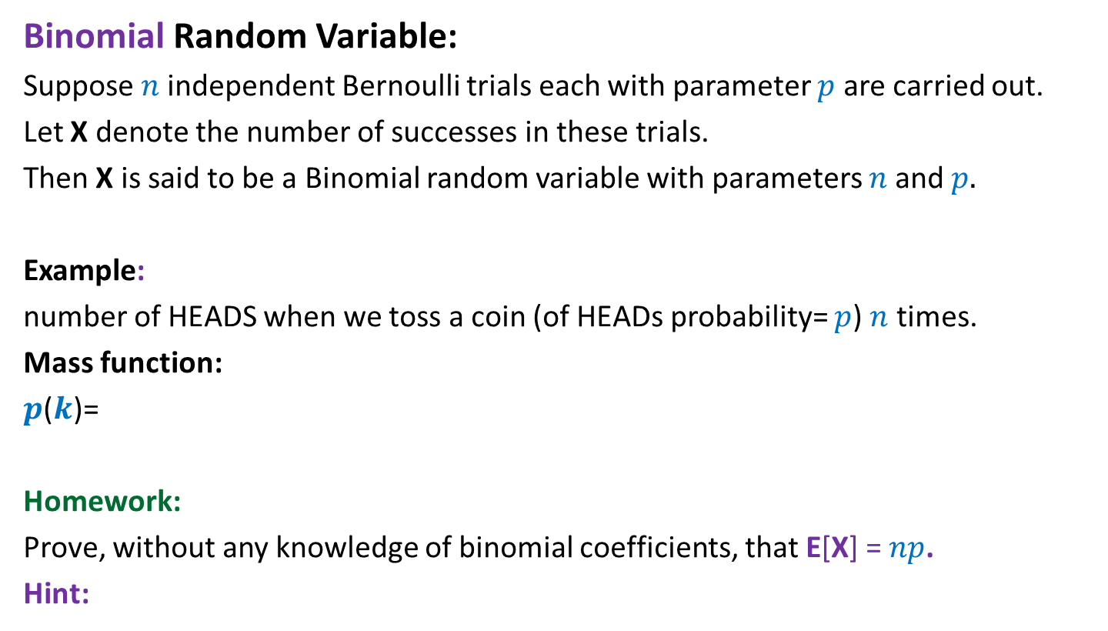

Binomial Random Variable
Binomial Random Variable:
Suppose $n$independent Bernoulli trials each with parameter $p$ are carried out.
Let X denote the number of successes in these trials.
Then X is said to be a Binomial random variable with parameters $n$and $p.$
Example:
number of HEADS when we toss a coin (of HEADs probability= $p$) $n$ times.
Mass function:
$p$($k$)=
Homework:
Prove, without any knowledge of binomial coefficients, that E[X] = $np$.
Hint:
$$\left({n \atop k}\right)p^{k}{\left(1−p\right)}^{k}$$
X = $X_{1}+…{+X}_{n}$
,where $X_{i}$ is a Bernoulli random variable for the $i$th Bernoulli trial.

Slide 6

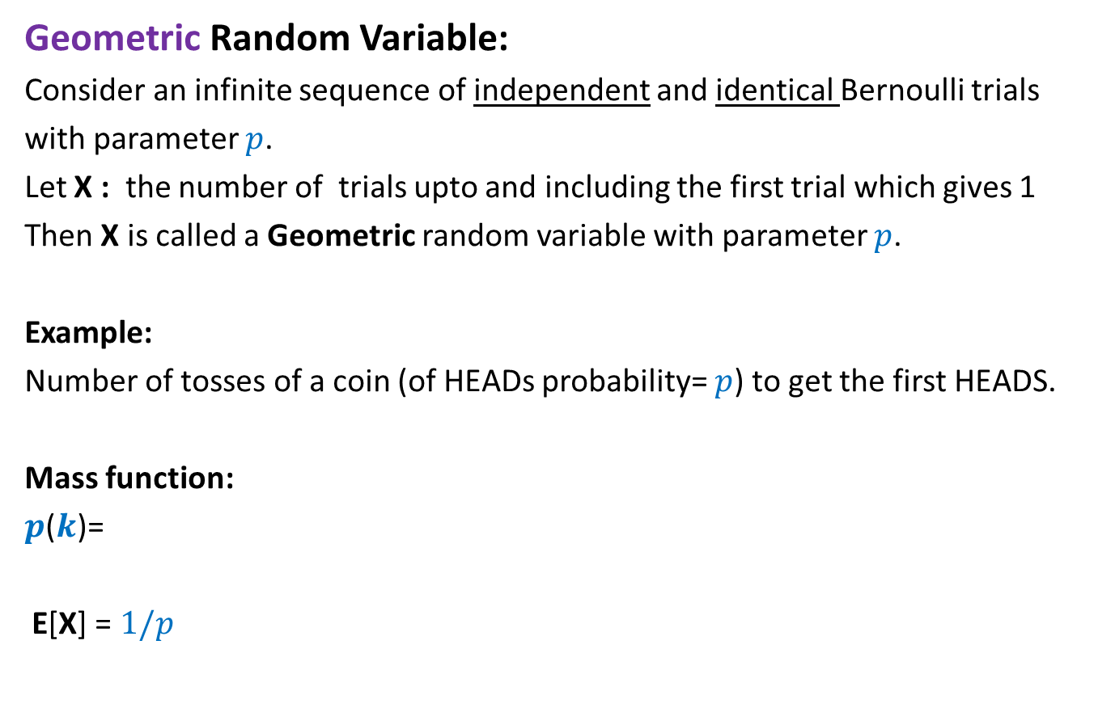
Geometric Random Variable
Geometric Random Variable:
Consider an infinite sequence of independent and identical Bernoulli trials
with parameter $p$.
Let X : the number of trials upto and including the first trial which gives 1
Then X is called a Geometric random variable with parameter $p$.
Example:
Number of tosses of a coin (of HEADs probability= $p$) to get the first HEADS.
Mass function:
$p$($k$)=
E[X] = $1/p$
$${\left(1−p\right)}^{k−1}p$$

Slide 7
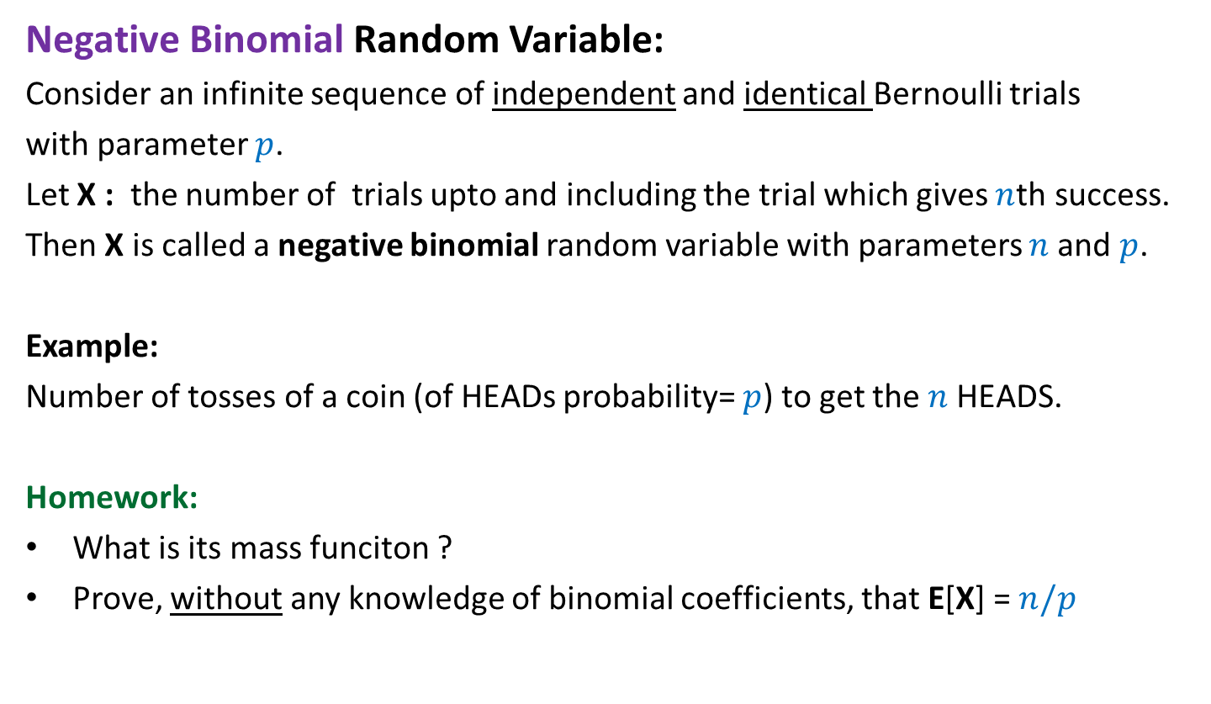
Negative Binomial Random Variable
Negative Binomial Random Variable:
Consider an infinite sequence of independent and identical Bernoulli trials
with parameter $p$.
Let X : the number of trials upto and including the trial which gives $n$th success.
Then X is called a negative binomial random variable with parameters $n$and $p$.
Example:
Number of tosses of a coin (of HEADs probability= $p$) to get the $n$HEADS.
Homework:
What is its mass funciton ?
Prove, without any knowledge of binomial coefficients, that E[X] = $n/p$

Slide 8
How to show
P[$X≥(1+ε)E[X]$]
P[$X≤(1−ε)E[X]$]

Slide 9
Tools
Markov’s Inequality
Chebyshev’s Inequality
Chernoff bound

Slide 10
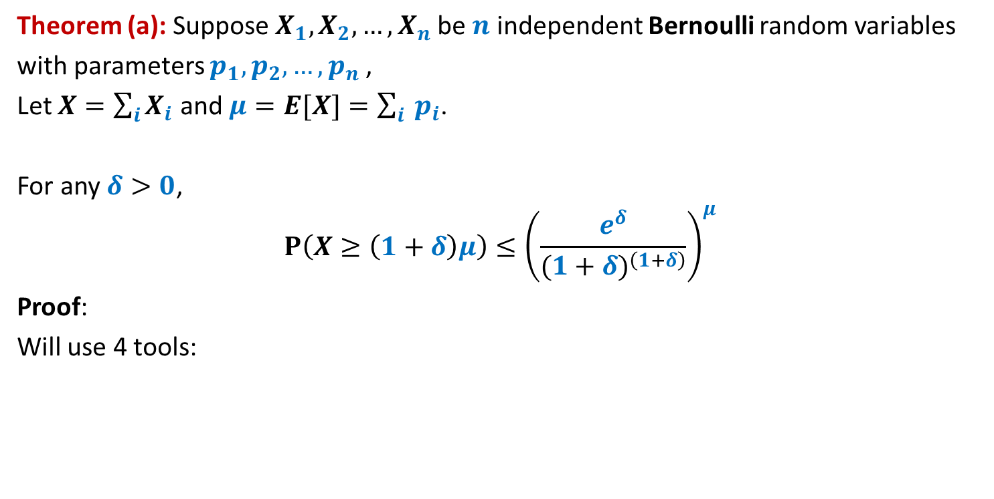
Chernoff’s Bound
Theorem (a): Suppose $X_{1},X_{2},…,X_{n}$be $n$ independent Bernoulli random variables
with parameters $p_{1},p_{2},…,p_{n}$,
Let $X=\sum_{i}{X_{i}}$ and $μ=E[X]=\sum_{i}{ p_{i}}$.
For any $δ>0$,
$$P\left(X≥\left(1+δ\right)μ\right)≤{\left(\frac{e^{δ}}{{(1+δ)}^{\left(1+δ\right)}}\right)}^{μ}$$
Proof:
Will use 4 tools:
Tool 1
Markov Inequality

Slide 11
Chernoff’s Bound
Theorem (a): Suppose $X_{1},X_{2},…,X_{n}$be $n$ independent Bernoulli random variables
with parameters $p_{1},p_{2},…,p_{n}$,
Let $X=\sum_{i}{X_{i}}$ and $μ=E[X]=\sum_{i}{ p_{i}}$.
For any $δ>0$,
$$P\left(X≥\left(1+δ\right)μ\right)≤{\left(\frac{e^{δ}}{{(1+δ)}^{\left(1+δ\right)}}\right)}^{μ}$$
Proof:
Will use 4 tools:
Tool 2
If $X$ and $Y$ are independent random variables,
$$E\left[X⋅Y\right]=E\left[X\right]⋅E[Y]$$

Slide 12
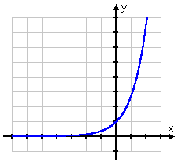
Chernoff’s Bound
Theorem (a): Suppose $X_{1},X_{2},…,X_{n}$be $n$ independent Bernoulli random variables
with parameters $p_{1},p_{2},…,p_{n}$,
Let $X=\sum_{i}{X_{i}}$ and $μ=E[X]=\sum_{i}{ p_{i}}$.
For any $δ>0$,
$$P\left(X≥\left(1+δ\right)μ\right)≤{\left(\frac{e^{δ}}{{(1+δ)}^{\left(1+δ\right)}}\right)}^{μ}$$
Proof:
Will use 4 tools:
Clearly
$$e^{x}≥1+x$$
$$e^{x}$$
Tool 3
$$1+x$$

Slide 13
Chernoff’s Bound
Theorem (a): Suppose $X_{1},X_{2},…,X_{n}$be $n$ independent Bernoulli random variables
with parameters $p_{1},p_{2},…,p_{n}$,
Let $X=\sum_{i}{X_{i}}$ and $μ=E[X]=\sum_{i}{ p_{i}}$.
For any $δ>0$,
$$P\left(X≥\left(1+δ\right)μ\right)≤{\left(\frac{e^{δ}}{{(1+δ)}^{\left(1+δ\right)}}\right)}^{μ}$$
Proof:
Will use 4 tools:
Tool 4
An elegant mathematical topic you studied in 11th class

Slide 14
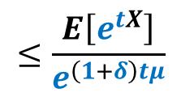
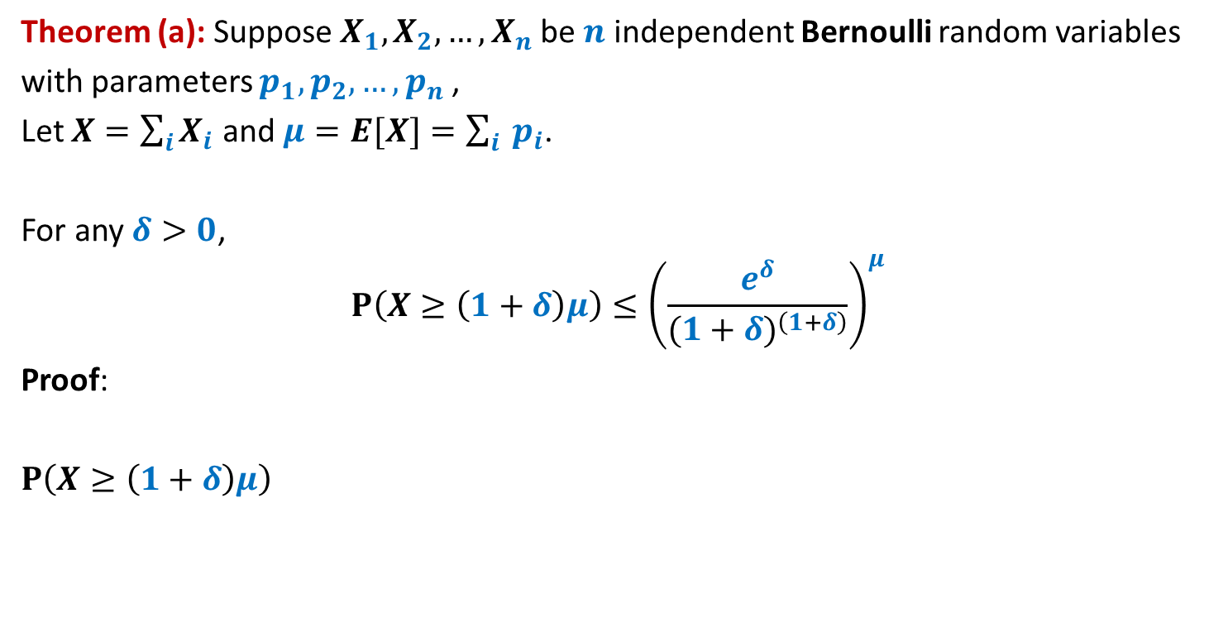
Chernoff’s Bound
Theorem (a): Suppose $X_{1},X_{2},…,X_{n}$be $n$ independent Bernoulli random variables
with parameters $p_{1},p_{2},…,p_{n}$,
Let $X=\sum_{i}{X_{i}}$ and $μ=E[X]=\sum_{i}{ p_{i}}$.
For any $δ>0$,
$$P\left(X≥\left(1+δ\right)μ\right)≤{\left(\frac{e^{δ}}{{(1+δ)}^{\left(1+δ\right)}}\right)}^{μ}$$
Proof:
$P\left(X≥\left(1+δ\right)μ\right)$
$$≤\frac{E\left[e^{tX}\right]}{e^{\left(1+δ\right)tμ}}$$
Tool 1
$$P\left(e^{tX}≥e^{\left(1+δ\right)tμ}\right)$$

Slide 15
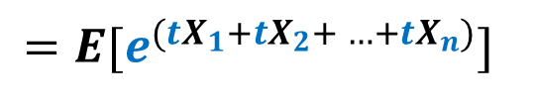
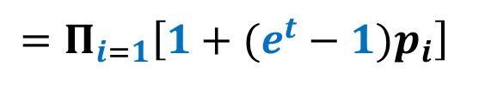

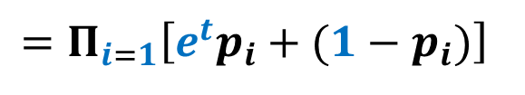
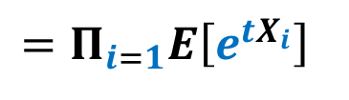
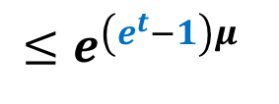
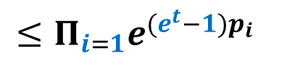
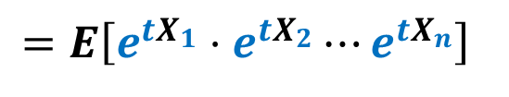
$$E\left[e^{tX}\right]$$
$$=E[e^{({tX}_{1}+{tX}_{2}+ …+tX_{n})}]$$
$$=E\left[e^{{tX}_{1}}⋅e^{{tX}_{2}}⋯e^{{tX}_{n}}\right]$$
$$=E\left[Π_{i=1}e^{{tX}_{i}}\right]$$
Tool 2
$$=Π_{i=1}E\left[e^{{tX}_{i}}\right]$$
$$=Π_{i=1}\left[e^{t}p_{i}+(1−p_{i})\right]$$
$$=Π_{i=1}\left[1+(e^{t}−1)p_{i}\right]$$
Tool 3
$$≤Π_{i=1}e^{(e^{t}−1)p_{i}}$$
$$≤e^{\left(e^{t}−1\right)μ}$$

Slide 16
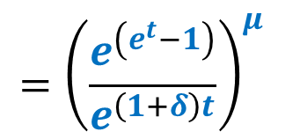
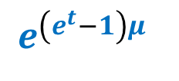
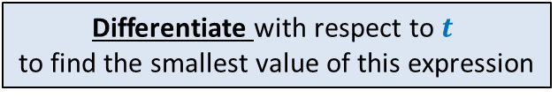

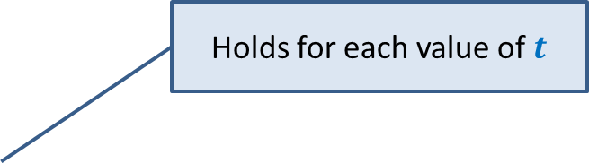

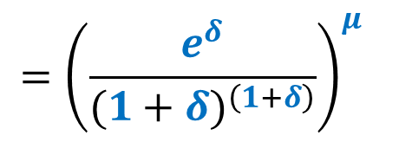
$$E\left[e^{tX}\right] ≤ e^{\left(e^{t}−1\right)μ}$$
$P\left(X≥\left(1+δ\right)μ\right)$
$$e^{\left(e^{t}−1\right)μ}$$
$$≤ \frac{E\left[e^{tX}\right]}{e^{\left(1+δ\right)tμ}}$$
Holds for each value of $t$
Tool 4
$$={\left(\frac{e^{\left(e^{t}−1\right)}}{e^{\left(1+δ\right)t}}\right)}^{μ}$$
Differentiate with respect to $t$
to find the smallest value of this expression
$$={\left(\frac{e^{δ}}{{(1+δ)}^{\left(1+δ\right)}}\right)}^{μ}$$
For $t=ln (1+δ)$

Slide 17
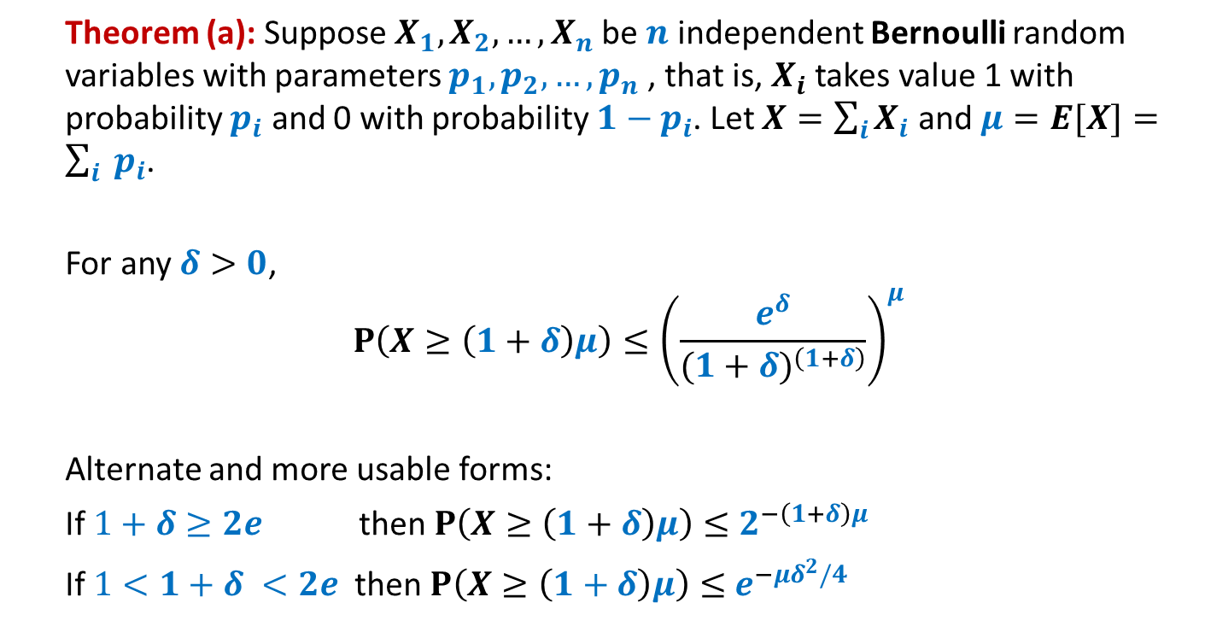
Chernoff’s Bound
Theorem (a): Suppose $X_{1},X_{2},…,X_{n}$be $n$ independent Bernoulli random variables with parameters $p_{1},p_{2},…,p_{n}$, that is, $X_{i}$ takes value 1 with probability $p_{i}$ and 0 with probability ${1−p}_{i}$. Let $X=\sum_{i}{X_{i}}$ and $μ=E[X]=\sum_{i}{ p_{i}}$.
For any $δ>0$,
$$P\left(X≥\left(1+δ\right)μ\right)≤{\left(\frac{e^{δ}}{{(1+δ)}^{\left(1+δ\right)}}\right)}^{μ}$$
Alternate and more usable forms:
If $1+δ≥2e$ then $P\left(X≥\left(1+δ\right)μ\right)≤$ $2^{−\left(1+δ\right)μ}$
If $1<1+δ <2e$ then $P\left(X≥\left(1+δ\right)μ\right)≤$ $e^{−μδ^{2}/4}$

Slide 18
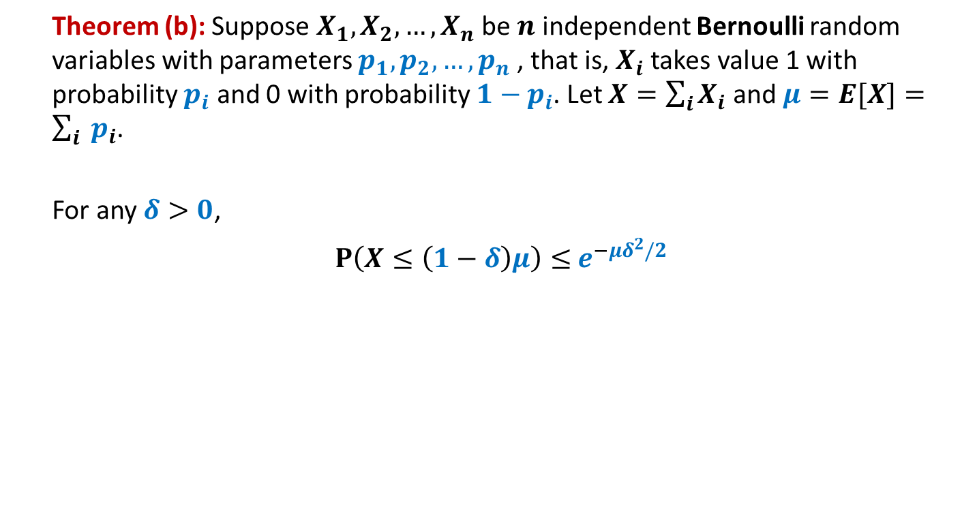
Chernoff’s Bound
Theorem (b): Suppose $X_{1},X_{2},…,X_{n}$be $n$ independent Bernoulli random variables with parameters $p_{1},p_{2},…,p_{n}$, that is, $X_{i}$ takes value 1 with probability $p_{i}$ and 0 with probability ${1−p}_{i}$. Let $X=\sum_{i}{X_{i}}$ and $μ=E[X]=\sum_{i}{ p_{i}}$.
For any $δ>0$,
$P\left(X≤\left(1−δ\right)μ\right)≤$ $e^{−μδ^{2}/2}$

Slide 19
Chernoff’s Bound
Where to use:
If given random variable X can be expressed as a sum of n mutually independent Bernoulli random variables.

Slide 20
Homework
For various problems till now, we used our knowledge of binomial coefficients, elementary probability theory and Stirling’s approximation for getting a bound on the probability of error or probability of deviation from average running time. Try to use Chernoff’s bound to analyze these problems.

